Slide 1


Interactive Choropleth Map Dashboard
Visualizing Data from the
Bureau of Labor Statistics
Justin, Hannah, Rob, Leanne, Lori
July 2021

Slide 2



BLS Interactive Choropleth Map
Bureau of Labor Statistics
Data Jobs
Tools
US Data Positions
Salary & Wages
Jupyter Notebook
HTML(CSS)/JS(D3/LEAFLET/_)
PostgreSQL
Notes:
Displaying Displaying an interactive dashboard to show trends in data science employment by state, using data from the Bureau of Labor Statistics.
Pulled data from the Bureau of Labor Statistics for May 2020
Cleaned and filtered data in Python/Pandas/Javascript
Geojson access through a flask API
Created dynamic United States map and tables with Javascript
Created an HTML dashboard to hold our visualizations

Slide 3
B.L.S. Job Codes Selected
We looked at B.L.S. employment summary data by state for the month of May 2020 and tapped the following Data Science job codes:
15-1211 Computer systems analysts
15-1221 Computer and information research scientists
15-1245 Database administrators and architects
15-2031 Operations research analysts
15-2041 Statisticians
15-1251 Computer programmers
15-1257 Web developers digital interface designers
15-2098 Data science mathematical science occupations all other

Slide 4
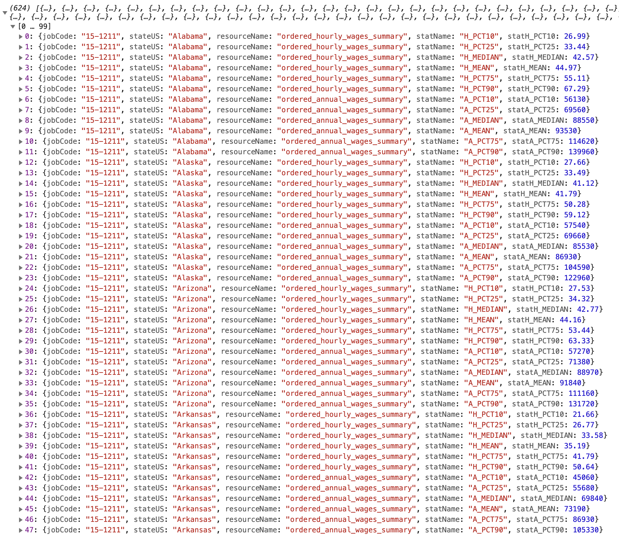
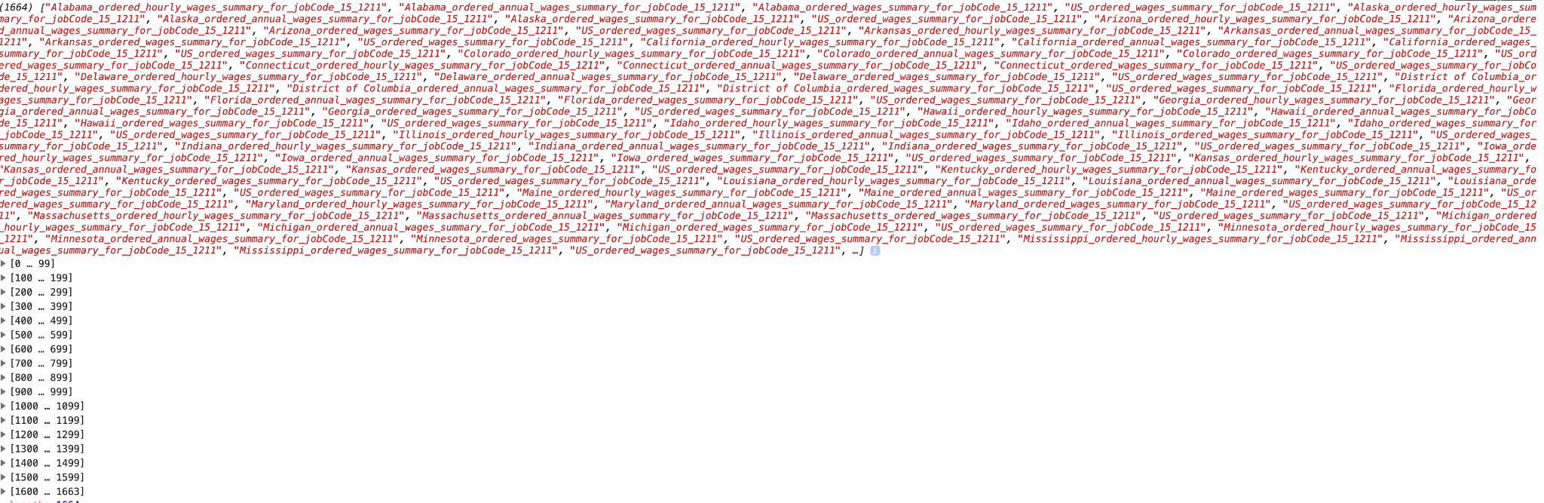
javascript data wrangling
staged csv’s w/ python&pandas filtering and filename assignment
used d3 to define js objects for each csv
then used javascript for the majority of the data processing
script generates unique variable names for each plotting dataset
script then calls a plotting dataset via user input
script updates plotting data and then refreshes table and map
script dynamically assigns colors based on called dataset values

Slide 5
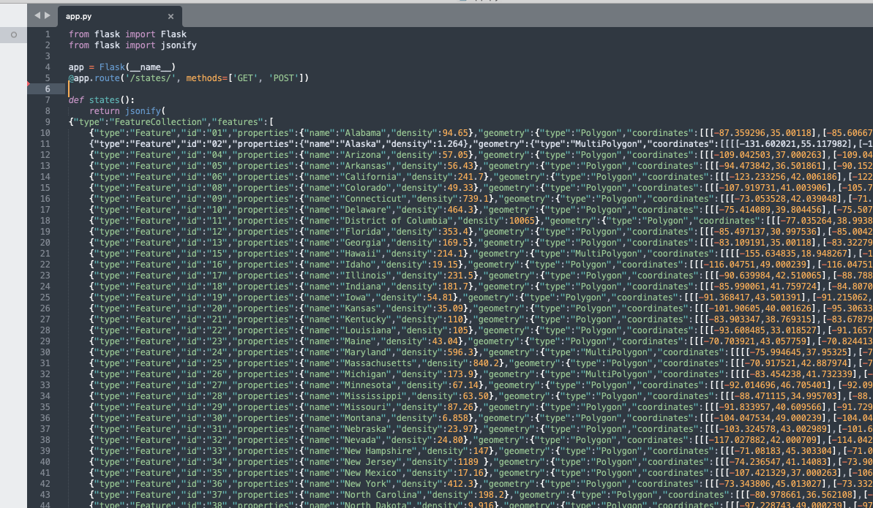
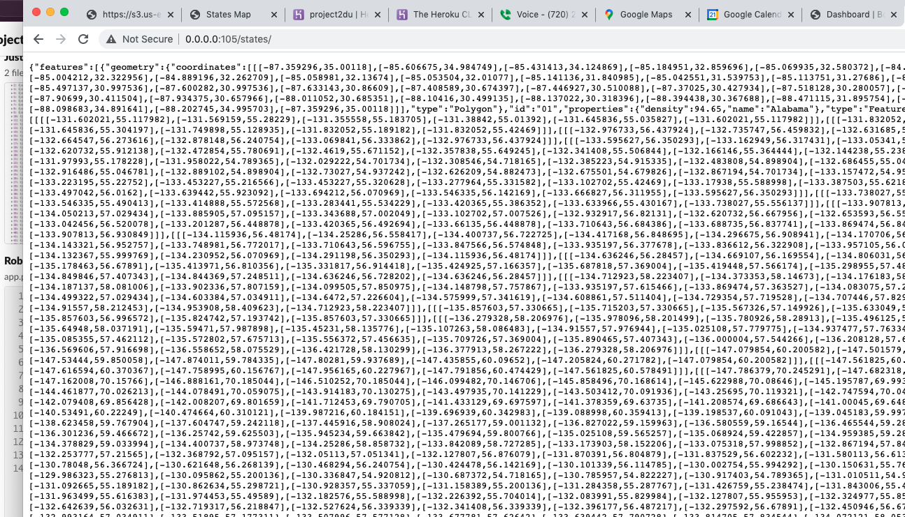
flask API provides access to the states geojson
Created a flask API to serve up the states plotting data source

Slide 6
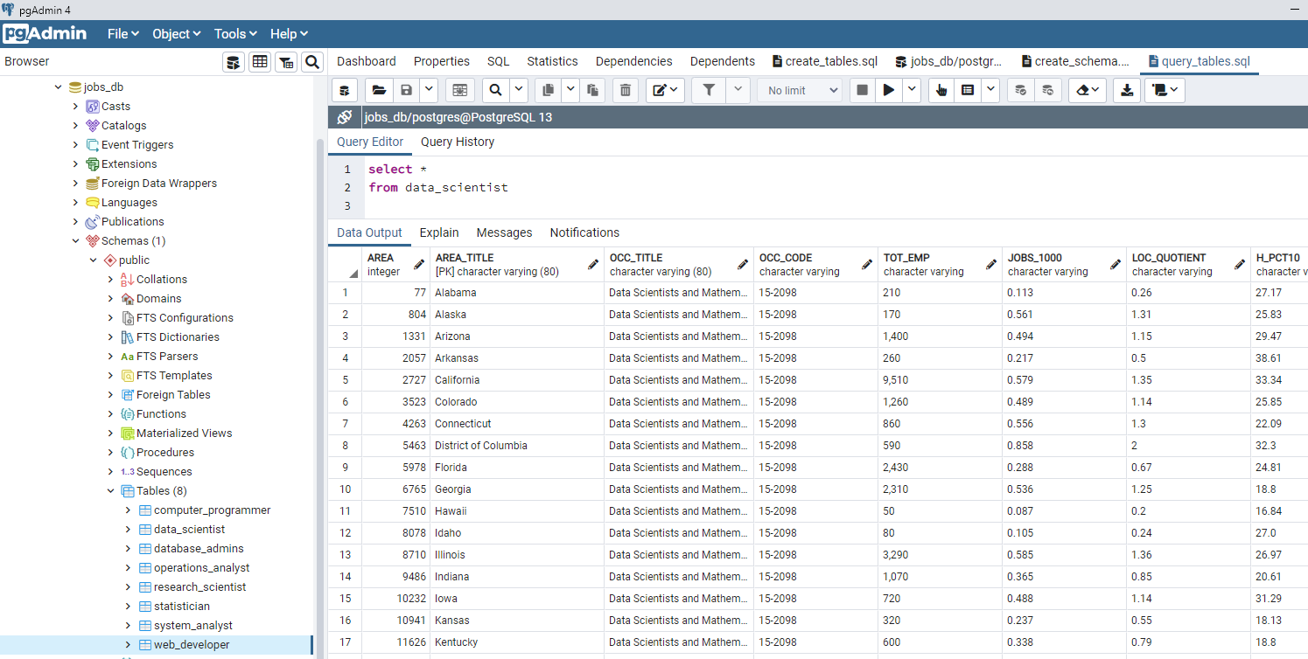
Jobs Database
Our Jobs database was created using a ETL process with PostgreSQL. Eight tables were created and populated from csv files

Slide 7
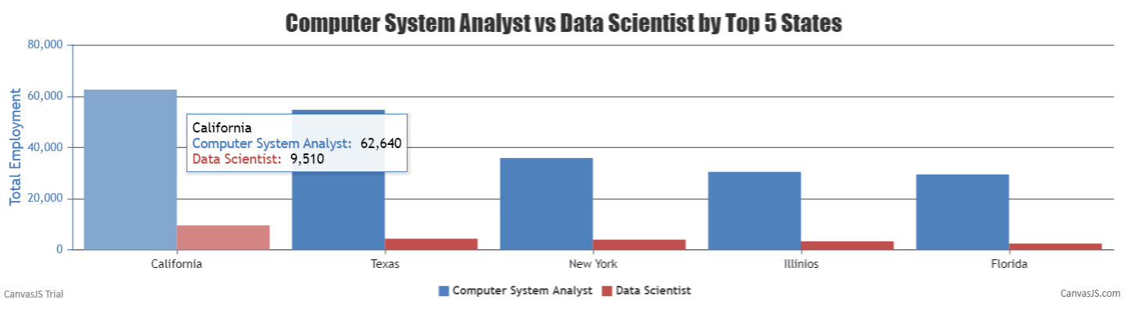
Bar Graph Using CanvasJS

Slide 8
Sources
Data Source - https://www.bls.gov/oes/current/oes151245.htm
Visualization Source - https://leafletjs.com/examples/choropleth/
Project Link - https://github.com/hannaholson/Project2.git

